Slide 1


Slide 2
Database
A very large, integrated collection of data.
A Database Management System (DBMS) is a software system designed to store, manage, and facilitate access to databases.

Slide 3
Database Management System
DBMS contains information about a particular enterprise
  Collection of interrelated data
  Set of programs to access the data
  An environment that is both convenient and efficient to use
Database Applications:
  Banking: all transactions
  Airlines: reservations, schedules
  Universities: registration, grades
  Sales: customers, products, purchases
  Online retailers: order tracking, customized recommendations
  Manufacturing: production, inventory, orders, supply chain
  Human resources: employee records, salaries, tax deductions

Slide 4
Purpose of Database Systems
In the early days, database applications were built directly on top of file systems
Drawbacks of using file systems to store data:
  Data redundancy and inconsistency
    Multiple file formats, duplication of information in different files
  Difficulty in accessing data
    Need to write a new program to carry out each new task
  Data isolation — multiple files and formats
  Integrity problems
    Integrity constraints (e.g. account balance > 0) become “buried” in program code rather than being stated explicitly
    Hard to add new constraints or change existing ones

Slide 5
Purpose of Database Systems
Drawbacks of using file systems (cont.)
  Atomicity of updates
    Failures may leave database in an inconsistent state with partial updates carried out
    Example: Transfer of funds from one account to another should either complete or not happen at all
  Concurrent access by multiple users
    Concurrent accessed needed for performance
    Uncontrolled concurrent accesses can lead to inconsistencies
      Example: Two people reading a balance and updating it at the same time
  Security problems
    Hard to provide user access to some, but not all, data
Database systems offer solutions to all the above problems

Slide 6
Levels of Abstraction
Physical level: describes how a record (e.g., customer) is stored.
Logical level: describes data stored in database, and the relationships among the data.
  type customer = record
  customer_id : string;
  customer_name : string;
  customer_street : string;
  customer_city : string;
        end;
View level: application programs hide details of data types. Views can also hide information (such as an employee’s salary) for security purposes.

Slide 7
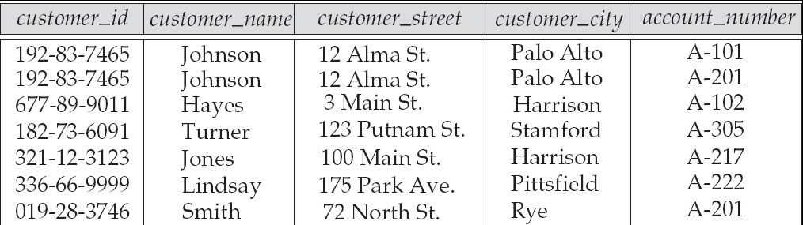
Relational Database (R-DBMS)
R-DBMS Stores data in table or relation.
For Example:
Row is also called tuple, record.
Column is also called attribute, field.

Slide 8
SQL(Structured Query Language)
SQL: It includes data definition language (DDL), statements that specify and modify database schemas.
An SQL relation is defined using the create table command:
create table r (A₁ D₁, A₂ D₂, ..., A_{n} D_{n},
(integrity-constraint₁),
...,
(integrity-constraint_{k}))
  r is the name of the relation
  each A_{i} is an attribute name in the schema of relation r
  D_{i} is the data type of attribute A_{i}

Slide 9
How to create a table ?
Example:
create table branch
(branch_name char(15),
branch_city char(30),
assets number(10));

Slide 10
Integrity Constraints on Tables
not null
primary key (A₁, ..., A_{n} )
Example: Declare branch_name as the primary key for branch
create table branch
(branch_name char(15),
branch_city char(30) not null,
assets number(10),
primary key (branch_name));
  primary key declaration on an attribute automatically ensures not null

Slide 11
Primary and foreign key
Primary key:
A column which can identify each row of the table uniquely is called primary key of the table.
Primary key should be ‘not null’.
Primary key should be ‘unique’.
Foreign key:
A key will be Foreign key in other (child) table if it is primary or unique in parent table. Foreign key will accept Null values in child table.

Slide 12
Candidate key
Candidate key:
All those key which are capable of being Primary key is known as candidate key.
Composite Candidate key:
If two key’s combined and generate a candidate key such that candidate key is Composite Candidate key.
Course table:
Roll_no Course_no Grade
01 C1 A
01 C2 B
02 C1 B
Here Roll_no and Course_no togather form a Candidate key.
If any attribute is a part of Composite Primary Key then they will not accept null values

Slide 13
Primary key and foreign key
Create a student table with student information (Roll_no , Name) Roll_no is primary key
create table student information
(Roll_no number(10) primary key,
Name varchar(10));
Create a table which contains information of student enrolled in which course. Roll_no foreign key references student table, course_id foreign key references course table.
create table courses_of_students (
Roll_no number(10), course_id number(10),
foreign key (Roll_no) references student(Roll_no),
foreign key (course_id) references course_info(course_id));

Slide 14
Basic Insertion and Deletion of Tuples
Newly created table is empty
Add a new tuple to account
insert into account
values ('A-9732', 'Perryridge', 1200);
Insertion fails if any integrity constraint is violated
Delete all tuples from account
delete from account;

Slide 15
Drop and Alter Table Constructs
The drop table command deletes all information about the dropped relation from the database.
The alter table command is used to add attributes to an existing relation:
alter table student add city varchar(10);
where city is the name of the attribute to be added to relation student and varchar(10) is the domain of city.
  All tuples in the relation are assigned null as the value for the new attribute.
The alter table command can also be used to drop attributes of a relation:
alter table student drop city;
where city is the name of an attribute of relation student
  Dropping of attributes not supported by many databases

Slide 16
Modification of the Database – Deletion
Delete all account tuples at the Patna branch
delete from account
where branch_name = 'Patna' ;
Delete all accounts at every branch located in the city ‘Needham’.
delete from account
where branch_name in (select branch_name
from branch
where branch_city = 'Needham') ;

Slide 17
Deletion
On delete cascade:
When we delete a value from parent table then in child table the row contain that value will be deleted.
On delete null
When we delete a value from parent table then in child table the value will be updated as null.

Slide 18
Basic Query Structure
A typical SQL query has the form:
select A₁, A₂, ..., A_{n}
from r₁, r₂, ..., r_{m}
where P
  A_{i} represents an attribute: name, roll_no, phone_no
  R_{i} represents a relation: student table, faculty table
  P is a predicate: where student.roll_no = 1301CS_ _

Slide 19
The select Clause
The select clause list the attributes desired in the result of a query
Example: find the names of all branches in the loan relation:
select branch_name
from loan;

Slide 20
The select Clause
SQL allows duplicates in relations as well as in query results.
To force the elimination of duplicates, insert the keyword distinct after select.
Find the names of all branches in the loan relations, and remove duplicates
select distinct branch_name
from loan;
The keyword all specifies that duplicates not be removed.
select all branch_name
from loan;

Slide 21
The select Clause
An asterisk in the select clause denotes “all attributes”
select *
from loan;
The select clause can contain arithmetic expressions involving the operation, +, –, *, and /, and operating on constants or attributes of tuples.
E.g.:
select loan_number, branch_name, amount * 100
from loan;

Slide 22
The where Clause
The where clause specifies conditions that the result must satisfy
  Corresponds to the selection predicate of the relational algebra.
To find all loan number for loans made at the Patna branch with loan amounts greater than Rs.1200.
select loan_number
from loan
where branch_name = 'Patna' and amount > 1200;
Comparison results can be combined using the logical connectives and, or, and not.

Slide 23
The from Clause
The from clause lists the relations involved in the query
  Corresponds to the Cartesian product operation of the relational algebra.
Find the Cartesian product borrower X loan
select *
from borrower, loan;
Find the name, loan number and loan amount of all customers having a loan at the Patna branch.
select customer_name, borrower.loan_number, amount
from borrower, loan
where borrower.loan_number = loan.loan_number and
branch_name = ‘Patna‘;

Slide 24
The Rename Operation
SQL allows renaming relations and attributes using the as clause:
old-name as new-name
E.g. Find the name, loan number and loan amount of all customers;
rename the column name loan_number as loan_id.
select customer_name, borrower.loan_number as loan_id, amount
from borrower, loan
where borrower.loan_number = loan.loan_number;

Slide 25
Tuple Variables
Tuple variables are defined in the from clause via the use of the as clause.
Find the customer names and their loan numbers and amount for all customers having a loan at some branch.
select customer_name, T.loan_number, S.amount
from borrower as T, loan as S
where T.loan_number = S.loan_number;
Find the names of all branches that have greater assets than
some branch located in Patna.
select distinct T.branch_name
from branch as T, branch as S
where T.assets > S.assets and S.branch_city = ‘Patna' ;
Keyword as is optional and may be omitted
borrower as T ≡ borrower T
  Some database such as Oracle require as to be omitted

Slide 26
String Operations
SQL includes a string-matching operator for comparisons on character strings. The operator “like” uses patterns that are described using two special characters:
  percent (%). The % character matches any substring.
  underscore (_). The _ character matches any character.
Find the names of all customers whose street includes the substring “Main”.
select customer_name
from customer
where customer_street like '% Main%' ;
Match the name “Main%”
like 'Main\%' escape '\'
Note: Escape make % as character in name not as an ‘wild card character’.

Slide 27
Ordering the Display of Tuples
List in alphabetic order the names of all customers having a loan in Perryridge branch
select distinct customer_name
from borrower, loan
where borrower loan_number = loan.loan_number and
branch_name = ‘Patna'
order by customer_name;
We may specify desc for descending order or asc for ascending order, for each attribute; ascending order is the default.
  Example: order by customer_name desc

Slide 28
Aggregate Functions
These functions operate on the multiset of values of a column of a relation, and return a value
avg: average of all value
min: minimum value
max: maximum value
sum: sum of all values
count: number of values

Slide 29
Aggregate Functions (Cont.)
Find the average account balance at the Patna branch.
select avg (balance)
from account
where branch_name = 'Patna' ;
Find the number of tuples in the customer relation.
select count (*)
from customer;
Find the number of depositors in the bank.
select count (distinct customer_name)
from depositor;

Slide 30
Aggregate Functions – Group By
Find the number of depositors for each branch.
select branch_name, count (distinct customer_name)
from depositor, account
where depositor.account_number = account.account_number
group by branch_name;
Note: Attributes in select clause outside of aggregate functions must
appear in group by list

Slide 31
Aggregate Functions – Having Clause
Find the names of all branches where the average account balance is more than Rs.1,200.
select branch_name, avg (balance)
from account
group by branch_name
having avg (balance) > 1200;
Note: Predicates in the having clause are applied after the formation of groups whereas predicates in the where clause are applied before forming groups.

Slide 32
Between clause
Write a query to find the name of employee whose salary is between 10,000 & 20,000.
Select *
  from employee
  where (salary >= 10,000 and salary <= 20,000);
  OR
Select *
  from employee
  where salary between 10,000 and 20,000;

Slide 33
Nested Subqueries
SQL provides a mechanism for the nesting of subqueries.
A subquery is a select-from-where expression that is nested within another query.
A common use of subqueries is to perform tests for set membership, set comparisons, and set cardinality.
E.g. select employee_name from employee where salary =
(select max(salary) from employee where salary >
(select max(salary) from employee));

Slide 34
“In” Construct
Find all customers who have both an account and a loan at the bank.
select distinct customer_name
from borrower
where customer_name in
(select customer_name from depositor );
Find all customers who have a loan at the bank but do not have
an account at the bank
select distinct customer_name
from borrower
where customer_name not in
(select customer_name from depositor );

Slide 35
Example Query
Find all customers who have both an account and a loan at the Patna branch.
select distinct customer_name
from borrower, loan
where borrower.loan_number = loan.loan_number and
branch_name = 'Patna' and (branch_name, customer_name ) in
(select branch_name, customer_name from depositor, account
where depositor.account_number = account.account_number );
Note: Above query can be written in a much simpler manner. The
formulation above is simply to illustrate SQL features.

Slide 36
“All” Construct
Find the names of all branches that have greater assets than all branches located in Patna.
select branch_name
from branch
where assets > all
(select assets
from branch
where branch_city = ‘Patna')

Slide 37
“Exists” Construct
Find all customers who have an account at all branches located in Patna.
select distinct S.customer_name
from depositor as S
where not exists (
(select branch_name
from branch
where branch_city = ‘Patna’)
except
(select R.branch_name
from depositor as T, account as R
where T.account_number = R.account_number and
S.customer_name = T.customer_name ));

Slide 38
Absence of Duplicate Tuples
The unique construct tests whether a subquery has any duplicate tuples in its result.
Find all customers who have at most one account at the Patna branch.
select T.customer_name
from depositor as T
where unique (
select R.customer_name
from account, depositor as R
where T.customer_name = R.customer_name and
R.account_number = account.account_number and
account.branch_name = 'Patna') ;

Slide 39
Example Query
Delete the record of all accounts with balances below the average at the bank.
delete from account
where balance < (select avg (balance )
from account );
  Problem: as we delete tuples from deposit, the average balance changes
  Solution used in SQL:
  1. First, compute avg balance and find all tuples to delete
  2. Next, delete all tuples found above (without recomputing avg or
  retesting the tuples)

Slide 40
Modification of the Database-Update
Increase all accounts with balances over Rs.10,000 by 6%, all other accounts receive 5%.
  Write two update statements:
  update account
  set balance = balance ∗ 1.06
  where balance > 10000;
  update account
  set balance = balance ∗ 1.05
  where balance ≤ 10000;
  The order is important

Slide 41

Joined Relations**
Join operations is used to fetch information from more than one table.
Join operations take two relations and return as a result another relation.
These additional operations are typically used as subquery expressions in the from clause
Join condition – defines which tuples in the two relations match, and what attributes are present in the result of the join.
Join type – defines how tuples in each relation that do not match any tuple in the other relation (based on the join condition) are treated.

Slide 42
Cartesian Product
Query
select employee_name, department_name from employee, department;
It will return a cartesian product of Employee and Department table.
Employee Table:
employee_no employee_name department_no
1 scott 10
2 smith 20
3 allen 10
4 ford 20
Department Table:
department_no department_name department_city
10 research delhi
20 finance mumbai

Slide 43
Cartesian Product
Result of the query will be:
employee_name department_name
scott research
scott finance
smith research
smith finance
allen research
allen finance
ford research
ford finance
Cartesian Product join table on common field in between them.
If one of the table is empty then it returns Phi (ϕ).

Slide 44
Natural join
On common field when we use ‘ = ’ sign it is called Natural Join.
Write a query to find the name of employee whose department is located in delhi,
select employee_name from employee where
employee.department_no = department.department_no and
department. department_city = ‘delhi’;

Slide 45
Inner Join, Outer Join
Inner Join
It returns all matched rows of the all tables which is participates in join.
Outer Join
It returns matched and unmatched rows of the all tables which is participates in join.
Left Outer Join
Right Outer Join
Full Outer Join

Slide 46
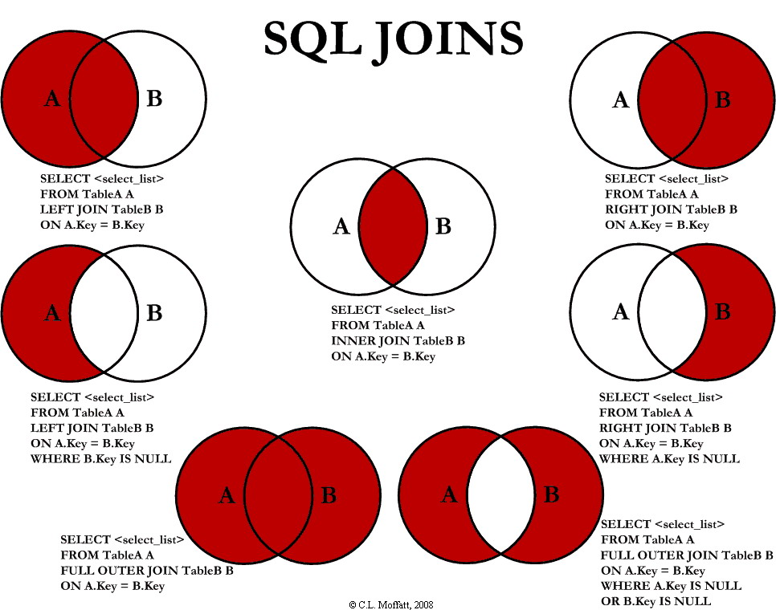


Slide 47
Example Left outer Join
Employee table
employee_name department_no
scott 10
allen null
smith 20
Department table
department_no department_name
10 research
20 finance
null marketing
select employee_name, department_name from employee, department where employee.department_name = department.department_name(+);
Result:
scott research
smith finance
allen null

Slide 48
Example Right outer Join
Employee table
employee_name department_no
scott 10
allen null
smith 20
Department table
department_no department_name
10 research
20 finance
null marketing
select employee_name, department_name from employee, department where (+)employee.department_name = department.department_name;
Result:
scott research
smith finance
null marketing

Slide 49

Joined Relations –
Datasets for Examples
Relation loan
Relation borrower
Note: borrower information missing for L-260 and loan information missing for L-155

Slide 50


Joined Relations – Examples
loan inner join borrower on
loan.loan_number = borrower.loan_number
loan left outer join borrower on
loan.loan_number = borrower.loan_number

Slide 51

Joined Relations – Examples
Joined Relations – Examples
loan natural right outer join borrower
Find all customers who have either an account or a loan (but not both) at the bank.
select customer_name
from (depositor natural full outer join borrower )
where account_number is null or loan_number is null ;

